Slide 1
SDN-Based DDOS
detection & mitigation
group13
b04902040王郁婷、b04902103蔡昀達、b04902108蘇彥齊、b03902092康譽騰

Slide 2
motivation
Software-defined networking (SDN) is an emerging network paradigm. Inspired by the capabilities of SDN, we present a comprehensive survey of existing SDN-based DDoS attack detection and mitigation solutions.

Slide 3
functions
Set up experiement environment with Ryu SDN Framework
Implement DDos attack
Implement several SDN-based DDoS detection mechanisms
Implement several SDN-based DDoS Defense Framework
Compare the effectiveness between different results

Slide 4
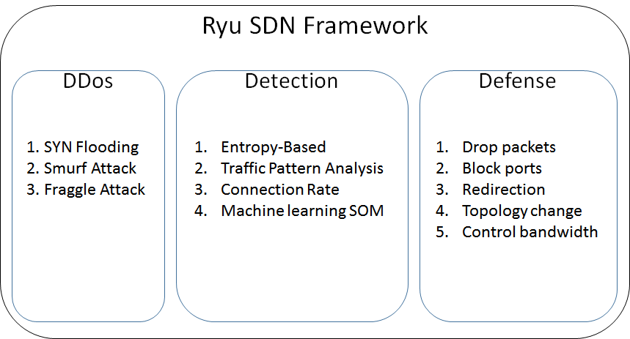
system structure

Slide 5
expected results
Baseline
Show effectiveness of each detection and mitigation approach
Identify pros and cons of each technique
Advanced
performace measure (detection rate, fp-rate, deployment cost, scalability)
External & internal DDoS attacks

